Slide 1

CSS part 1
Let’s know more about Cascading Style Sheets
Prepared by Helena Natanael, for FWD by dibimbing.id

Slide 2






Hi there!
you can call me Helen :)
Start sharing
knowledge
Start learning
HTML and CSS
Internship
Fullstack Webdev
First time job
Software Engineer
2010
2014
2018
2021
2023
Helena Natanael’s Life Journey
Getting a
Bachelor Degree
Taking IT as
Univ Major
Changing work
Software Engineer

Slide 3
1
CSS Syntax
2
CSS Selector
3
Color
Outline
4
Font
5
Text Alignment
6
List

Slide 4
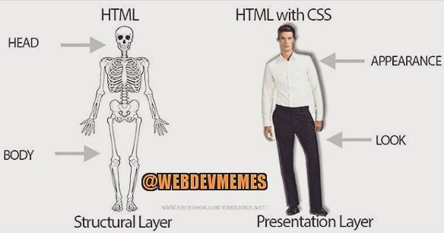
1 of 20

Slide 5
Importing CSS Files
There are 3 ways to import the CSS Files. Anyone know?
2 of 20

Slide 6
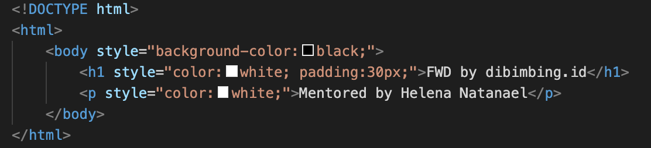
1 Inline CSS
Pros:
good for small changes
Cons:
will make code less readable if the styles applied is complex
styles only applied within the scope, need to reapply in each element
3 of 20

Slide 7
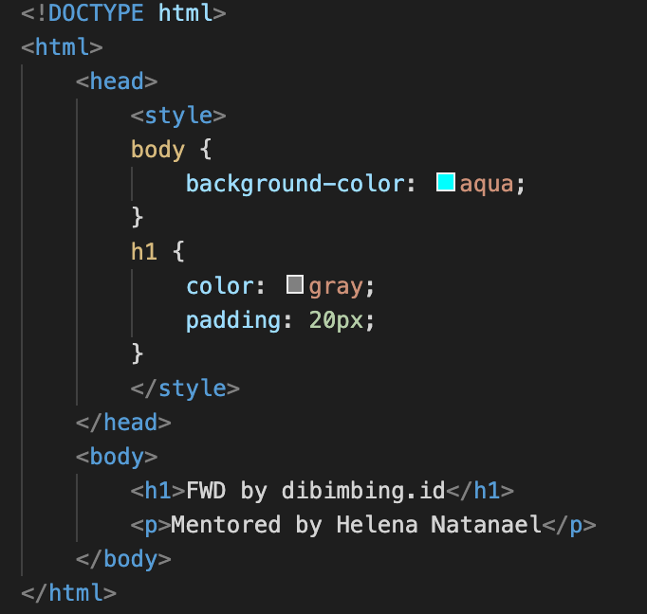
2 Internal CSS
Pros:
can reuse style for some elements
can use CSS selector
Cons:
will make too long line of code if applied in complex page
styles only applied within the file, cannot be reused in different html file
4 of 20

Slide 8
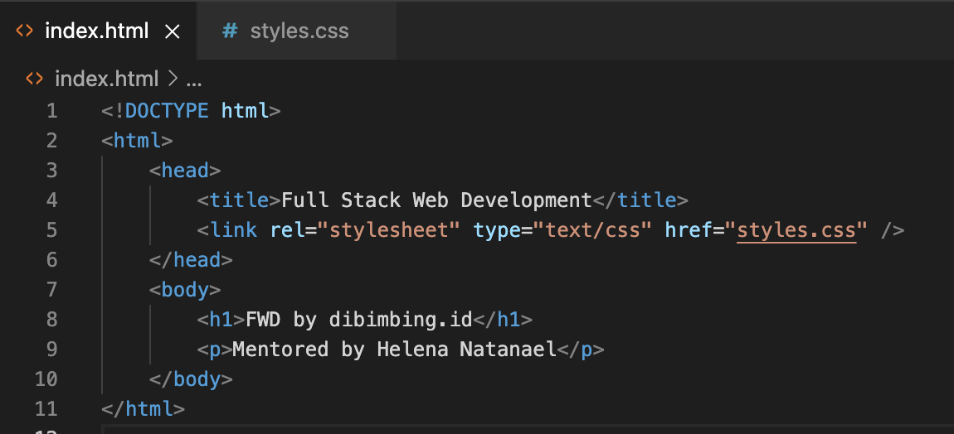
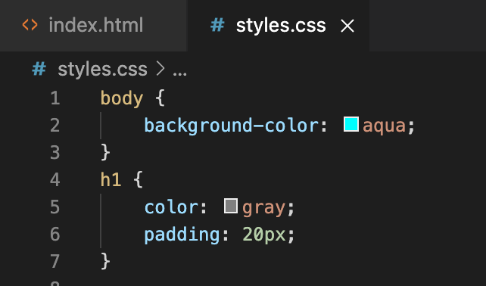
3 External CSS
Pros:
neat code structure, easy to maintain, readable
styles can be reused across files / pages
can use CSS selector
Cons:
css will not be loaded if the path is wrong (typo, server structure)
styles will not be applied in the page until the file is fully loaded in network
5 of 20

Slide 9
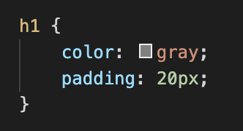
CSS Syntax
property
selector
value
declaration
]
declaration
block
declaration
6 of 20

Slide 10
CSS Selector
There are 5 ways to select the part of HTML that we want to style:
Class selector
ID selector
Tag selector
Attribute selector
Universal Selector
7 of 20

Slide 11
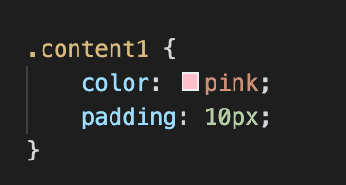
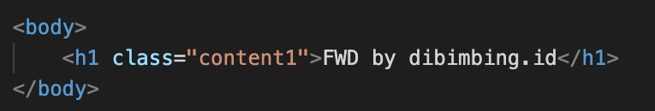
1 Class Selector
Select class of the element that we want to style. Most used selector in modern Web Apps.
8 of 20

Slide 12
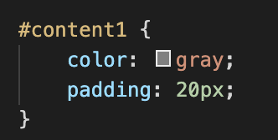
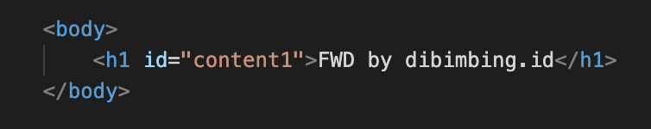
2 ID Selectors
Select ID of the element that we want to style.
Pros:
useful if we want to use specific style for an element in the page
Cons:
not suitable if want to apply the style in some elements, because can only used once
9 of 20

Slide 13
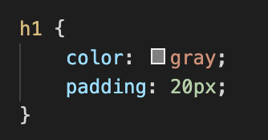
3 Tag Selector
Select directly the tag that we want to style, example: h1, div, span, img, p, etc.
Pros:
useful if we want to use same style for all same tag in the page
Cons:
in real life, this is rarely used (usually only used for heading tag) because each tag usually has their own style
10 of 20

Slide 14
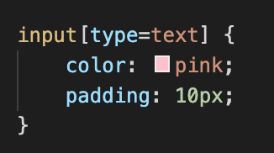
4 Attribute Selector
Selecting a tag selector and make it specific by using their attribute.
Not all HTML tag can use this.
11 of 20

Slide 15
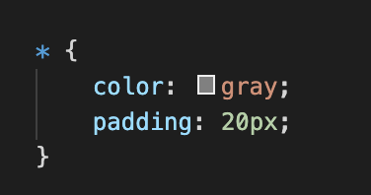
5 Universal Selector
Apply the style into all elements in HTML page
12 of 20

Slide 16
Color
There is some classifications of color in HTML. Let’s discuss it one by one!
13 of 20

Slide 17
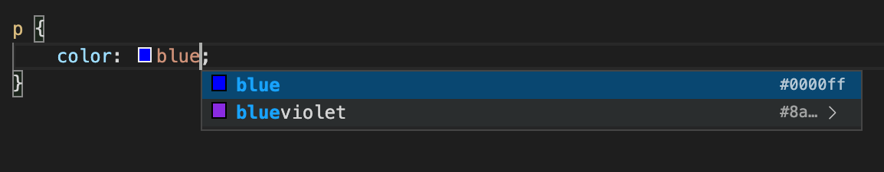
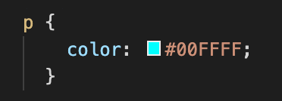
1 Named Colors
2 Hex Colors
14 of 20

Slide 18
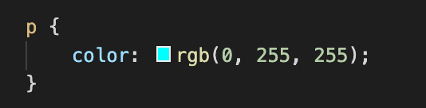
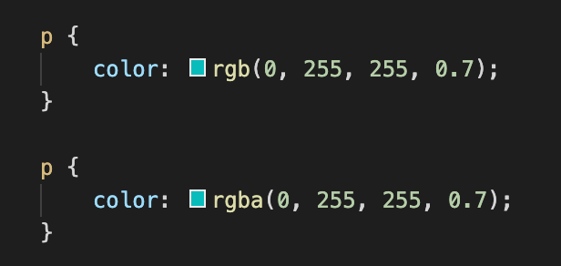
3 RGB (Red Green Blue) Colors
4 Alpha Channel for Opacity
15 of 20

Slide 19
Ice Breaking

Slide 20
Font
font-family
font-weight
font-size
line-height
16 of 20

Slide 21
Text Alignment
Just like MS Word, we can set text alignment in a Web App. property name: text-align
values: left, right, center, justify, inherit
17 of 20

Slide 22
List
in HTML, there is 2 type of list: unordered list (ul) and ordered list (ol). We will discuss about list styling using CSS.
Properties: list-style-type, list-style-position, list-style-image Demo: https://codepen.io/impressivewebs/pen/tIEKG
18 of 20

Slide 23
Insights: CSS Specificity
In a complex Web Apps, there is high chance that a style conflicts with another style in the same element. To avoid the ambiguity, the browser follow the rules of CSS Specificity.
Hierarchy:
Inline style
ID selector
Class Selector, Attribute Selector
Tag Selector
Universal Selector
If the conflicts is between same hierarchy, the latest rule applied.
19 of 20

Slide 24
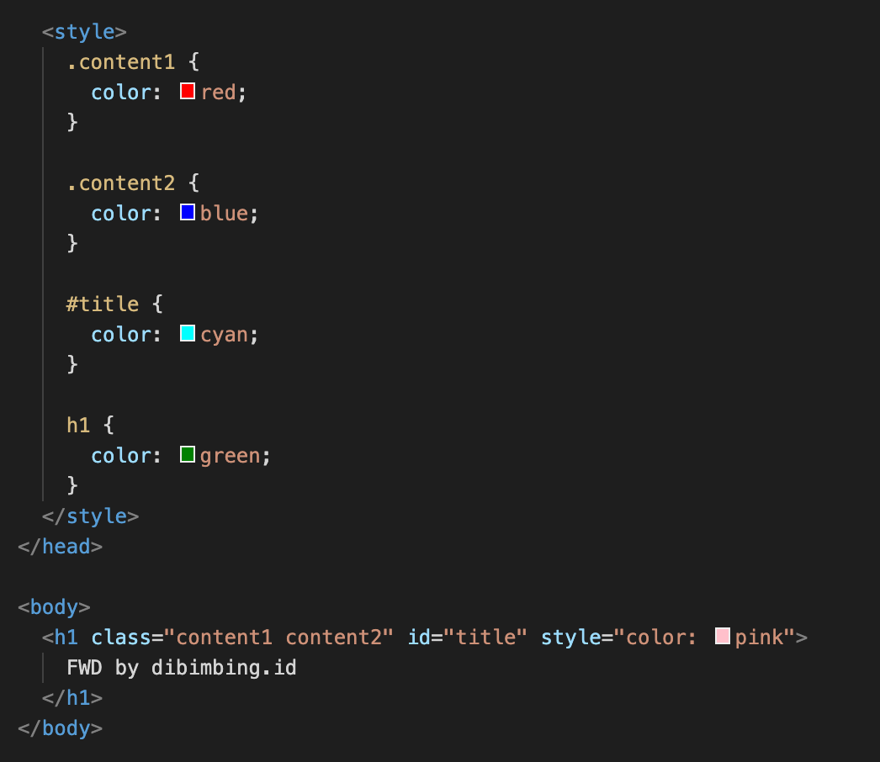
Pop Quiz
Let’s determine, which style is applied into this code snippet?
20 of 20

Slide 25
Thank you
That’s all for this session!
References:
https://css-tricks.com/ https://www.petanikode.com/css-selektor/ https://www.w3schools.com/css/css_specificity.asp
Prepared by Helena Natanael, for FWD by dibimbing.id

